Slide 1

CSA3716- Software Testing for Test Automation
ONLINE API TESTING PLATFORM USING WEB UI
Supervisor
JAISHARMA KRISHNAMOORTHY
Saveetha School Of Engineering
By
Anjireddy– (192211719)
manohar--(192210723)

Slide 2




INTRODUCTION
Online API Testing Platform Using Web UI supports critical workflows such as API request creation, HTTP method execution, response viewing, and real-time validation of endpoints.
To ensure reliability and accuracy, testing must validate request handling, response correctness, status codes, and error management.
This project focuses on end-to-end evaluation of API functionality, usability of the web interface, and secure handling of request/response data.

Slide 3

OBJECTIVES
Testing Scope
Validate API workflows: GET, POST, PUT, DELETE request handling
Check API authentication & request validation
Validate API response behavior and backend accuracy
Ensure proper error handling for invalid URLs and methods
Verify response status codes and JSON data correctnessTech Stack
Tech Stack
API Testing: Web UI (Flask-based platform)
Backend: Python (Flask Framework)
HTTP Requests: Requests Library
Frontend: HTML, CSS, JavaScript

Slide 4
MODULE 1:CLINICAL AND FUNCTIONALITY TESTING
Module 1 :
This module handles the main API testing features of the web platform:
API URL input
HTTP method selection (GET, POST, PUT, DELETE)
Request body and header configuration
Response display section
Real-time API result validation
How Module 1 Works
User enters API URL in the web interface
System allows selection of HTTP method
User optionally enters request data (JSON, headers)
Request is sent to the backend API handler
System fetches response from server
Results (data, status code, errors) are displayed instantly in UI

Slide 5
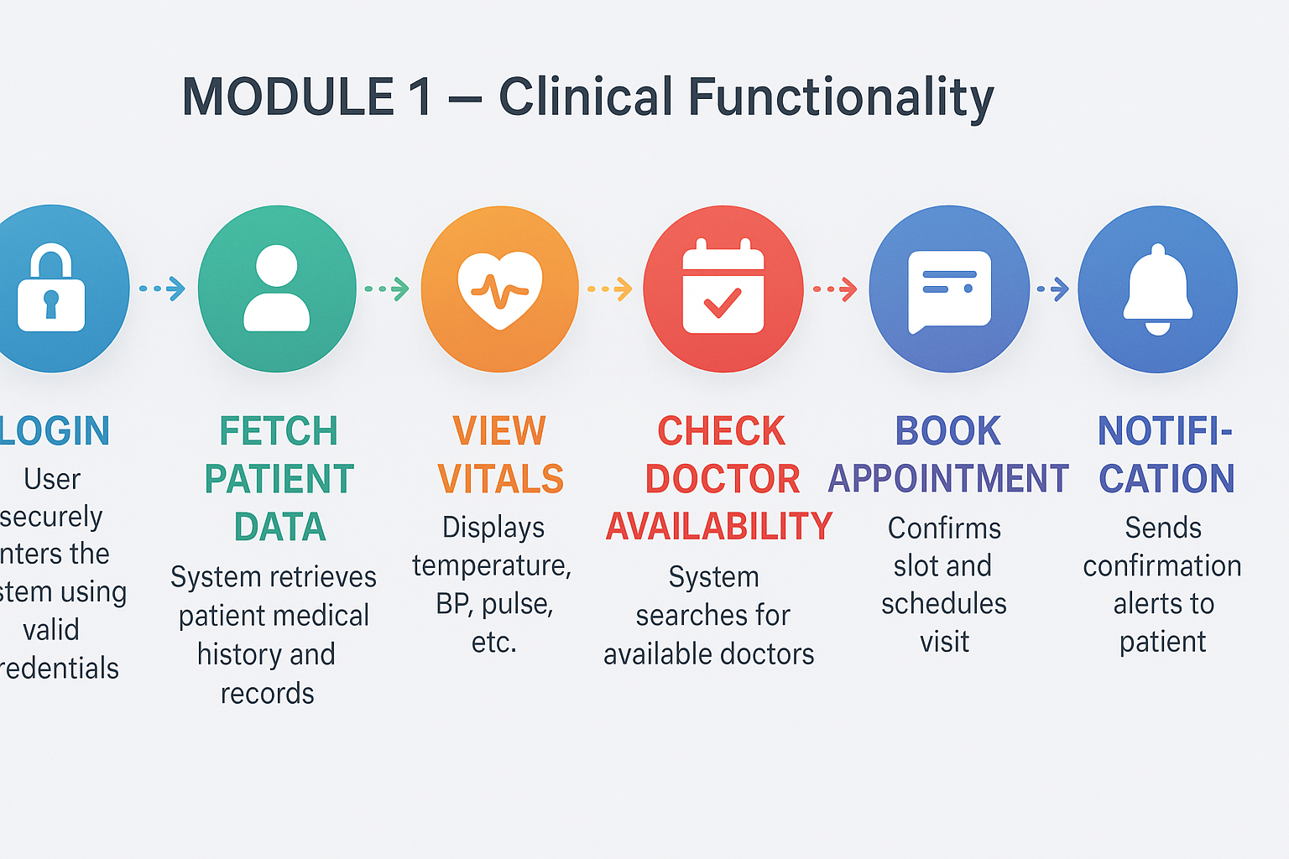
MODULE 1-SYSTEM ARCHITECTURE

Slide 6
MODULE 1 - TESTCASES
Test Case | TEST SCENARIO | TEST DESCRIPTION | INPUT | EXPECTED RESULT
TC1 | API URL Input | Validate user enters valid API URL | https://jsonplaceholder.typicode.com/posts/1 | API accepted successfully
TC2 | GET Request | Validate GET request retrieves data | Method = GET | Response data displayed with status code 200
TC3 | POST Request | Validate POST request sends new data | Method = POST + JSON Body | New data created successfullyd

Slide 7

Module 2: SECURITY AND USABILITY TESTING
Security Testing:
Performed using Web UI / Postman to validate:
API Access Control (authorized/unauthorized requests)
Token Validation (JWT/API keys authentication)
Data Protection (secure request & response handling)
Usability Testing:
Simple and intuitive Web UI for API testing
Easy navigation for selecting HTTP methods and entering API URL
Clear layout for request and response display
Accessibility support (readable fonts, proper buttons, contrast colors)
Smooth workflow without user confusion or delay

Slide 8
MODULE 2 - TESTCASES
Test Case | TEST SCENARIO | TEST DESCRIPTION | PRE-CONDITION | EXPECTED RESULT
TC4 | PUT Request Testing | Access endpoint without token | Validate PUT request updates existing data | Existing data updated successfully
TC5 | DELETE Request Testing | Validate API with expired token | Validate DELETE request removes data | Selected data deleted successfully
TC6 | INVALID API Ruquest | Validate masking of sensitive fields | Validate system behavior with wrong API URL | Existing data updated successfully

Slide 9
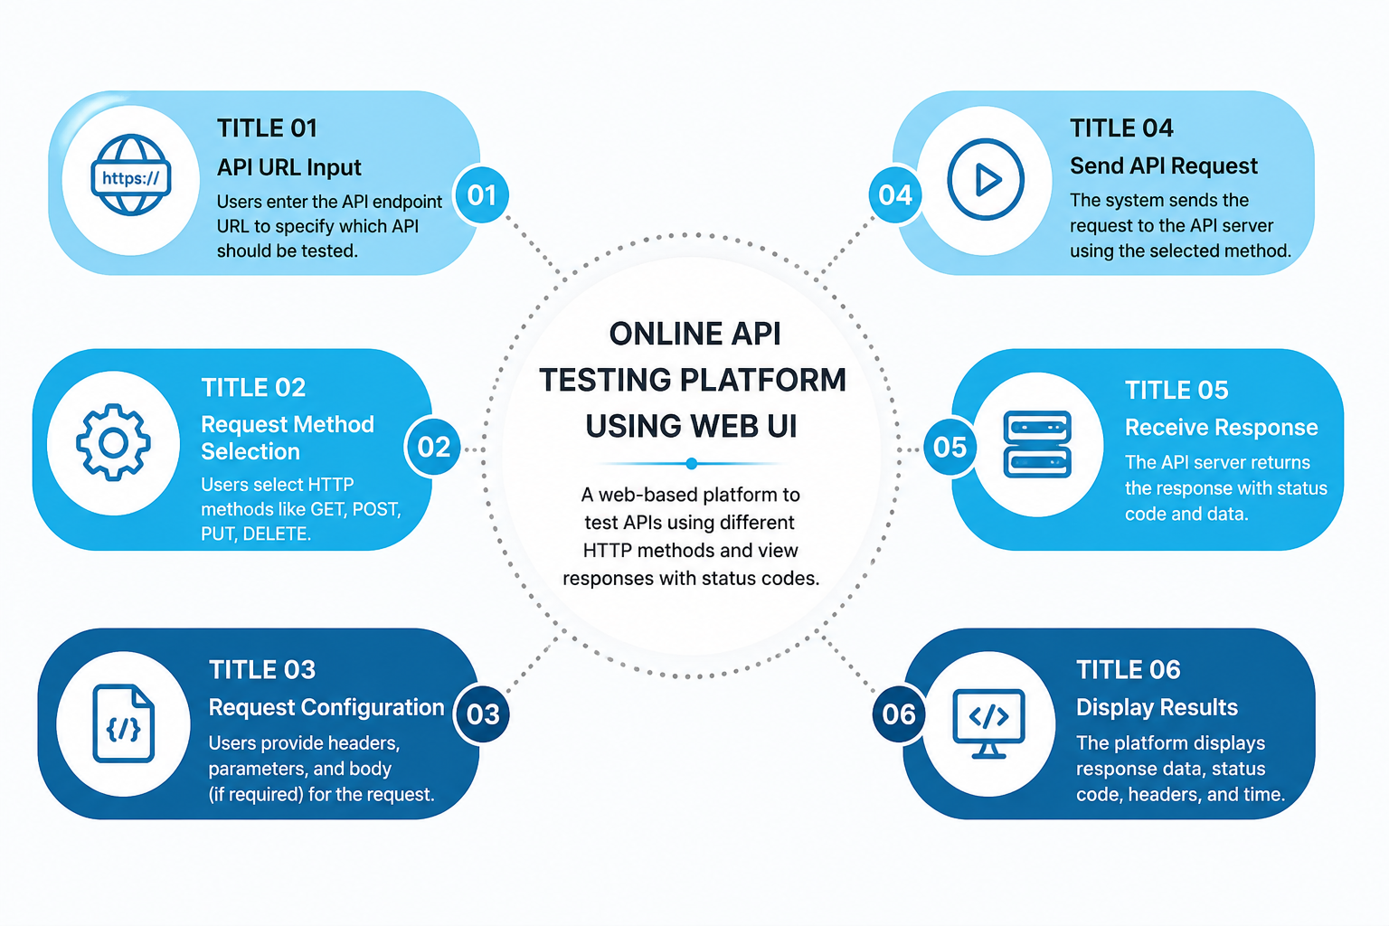
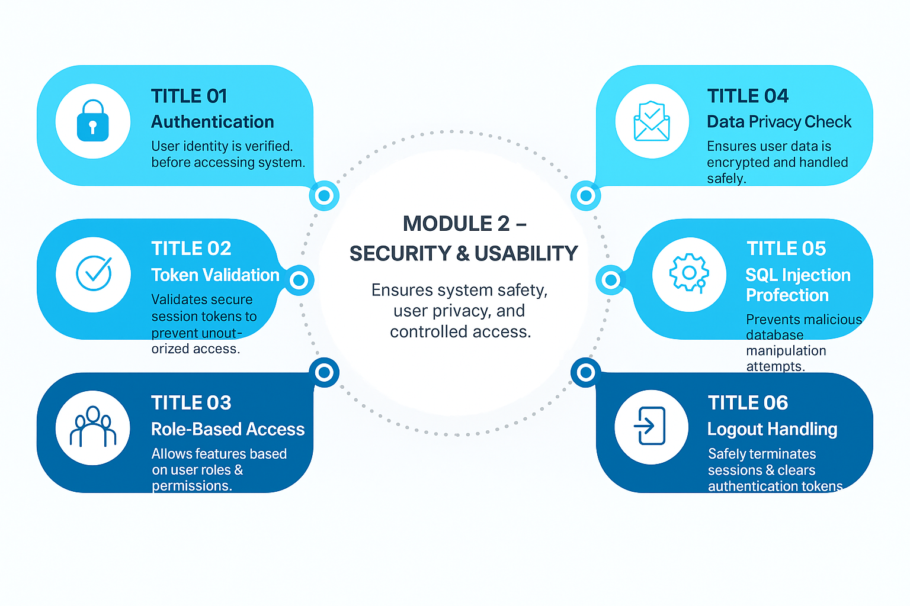
FLOWCHART
MODULE 3

Slide 10
TECHNIQUE’s USED
S. No | Testing Technique | Purpose in This Project
1 | Functional Testing | Validation of API request and response workflow
2 | API Testing | Testing API endpoints using GET, POST, PUT, DELETE methods
3 | Performance Testing | Checking response timeand sever performace
4 | Security Testing | Token validation and secure access Checks
5 | Usability Testing | User Flow And Experience Evaluation

Slide 11
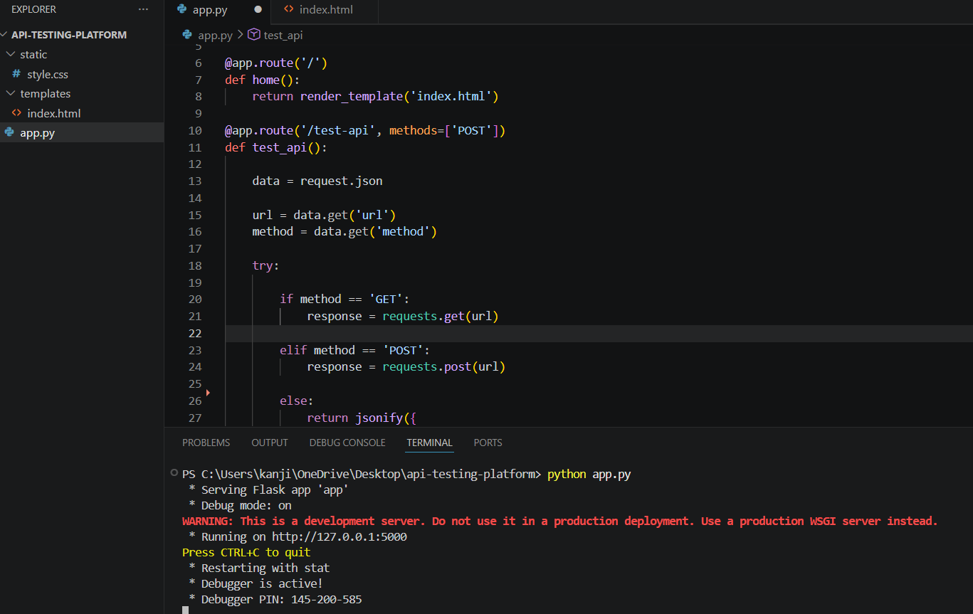
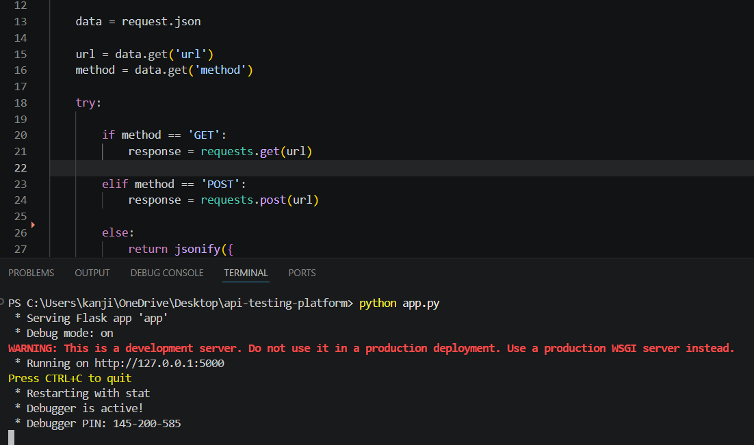
VS IMPLEMENTATION

Slide 12
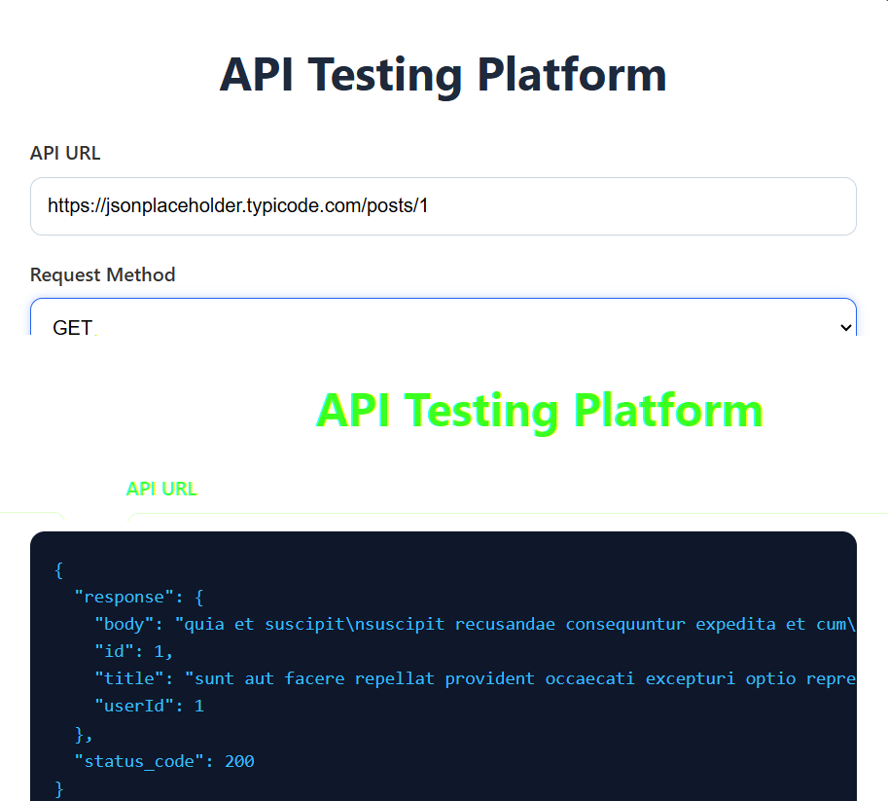
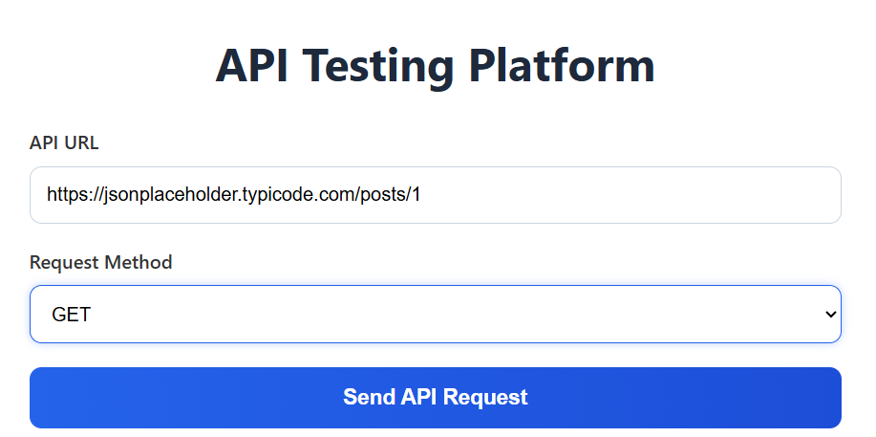
IMPLEMENTATION

Slide 13
RESULT
All core modules—API request handling (GET, POST, PUT, DELETE), response display, and error handling—performed correctly.
API responses were accurate and returned proper JSON data under different test scenarios.
Status codes (200, 404, 500) were correctly validated for different API inputs.
The system successfully handled valid and invalid API URLs with proper output messages.
DISCUSSION
The Online API Testing Platform proved to be effective for validating REST APIs through a simple web interface.All functionalities matched expected outcomes, ensuring:
➤ Accurate API response display in JSON format
➤ Proper handling of GET, POST, PUT, DELETE methods
➤ Reliable error detection for invalid API requests
➤ User-friendly interface for easy API testing and debugging
Minor improvements such as adding authentication support, saving test history, and response time analytics can further enhance the system for advanced usage.

Slide 14
Future Enhancement
AI-Based API Error Detection & Smart Suggestions
Real-Time API Monitoring and Performance Tracking
Biometric Authentication for Secure User Access
Integrated Chatbot for 24/7 User Assistance
Automated API Test Report Generation and Export Feature

Slide 15
Conclusion
Online API Testing Platform Using Web UI ensures accurate, secure, and reliable API testing for different web services.
By applying functional, performance, security, and usability testing, the platform becomes more efficient and user-friendly.
The system successfully validates API responses, status codes, request methods, and error handling under different scenarios.
A well-tested API platform improves developer productivity, testing accuracy, and overall application reliability.
Continuous enhancements and testing are essential to maintain system performance, security, and user satisfaction

Slide 16


